Slide 1
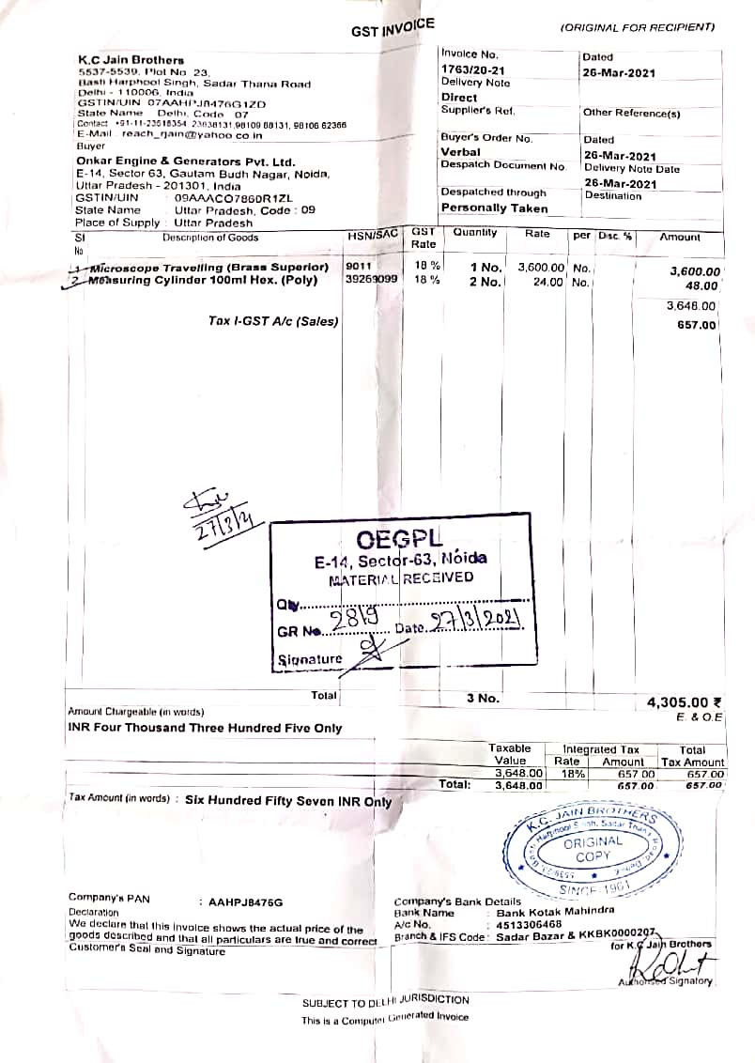
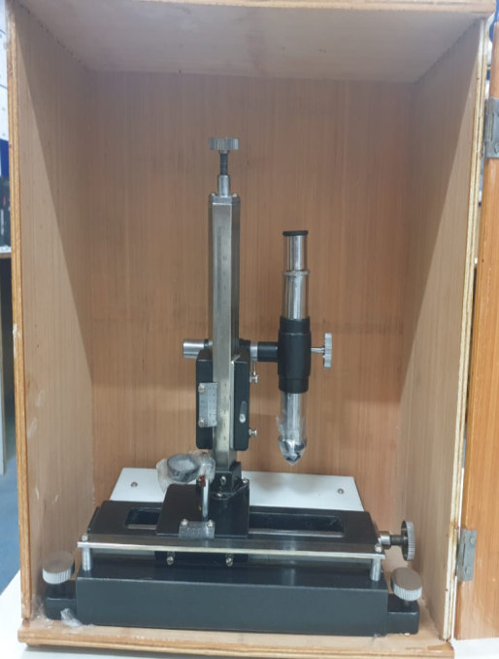
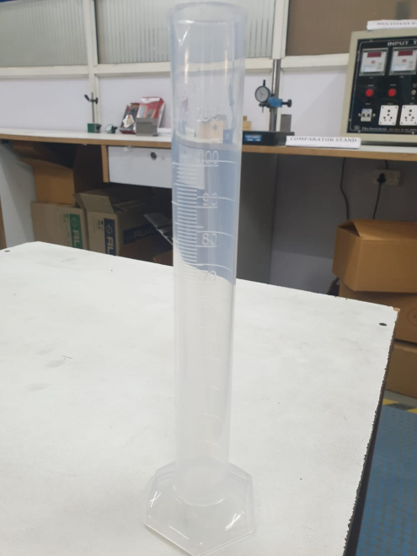
Annex 1
Reference DCAR report (CM/A 87001389) on dated 24.03.21
Travelling Microscope required for Ball pressure test & Measuring Cylinder
Purchase Invoice
Travelling Microscope
Measuring Cylinder

Slide 2
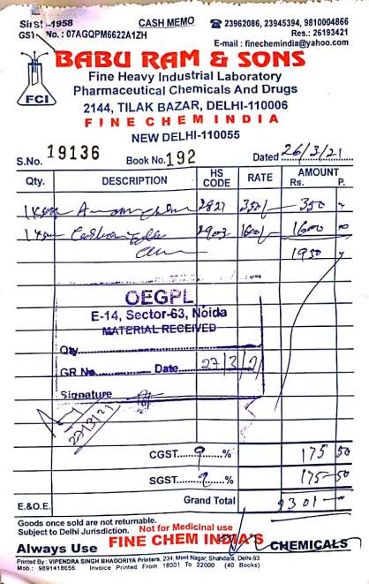
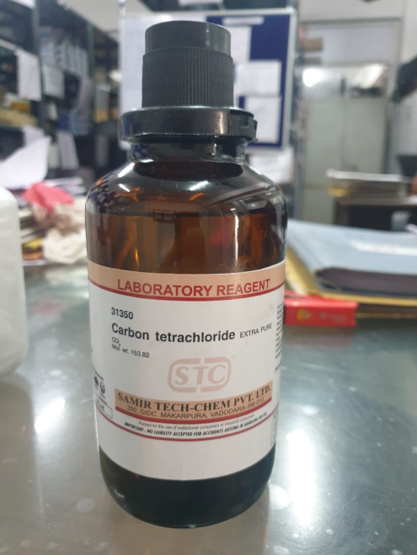
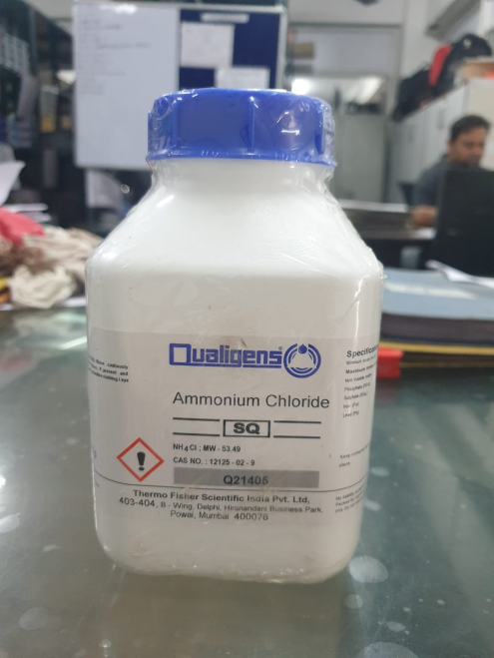
Annex 2
Reference DCAR report (CM/A 87001389) on dated 24.03.21
Ammonium chloride & Carbon tetrachloride
Purchase
Invoice
Carbon tetrachloride
Ammonium chloride

